Slide 1

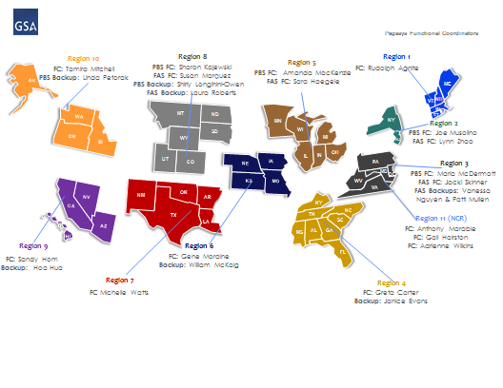
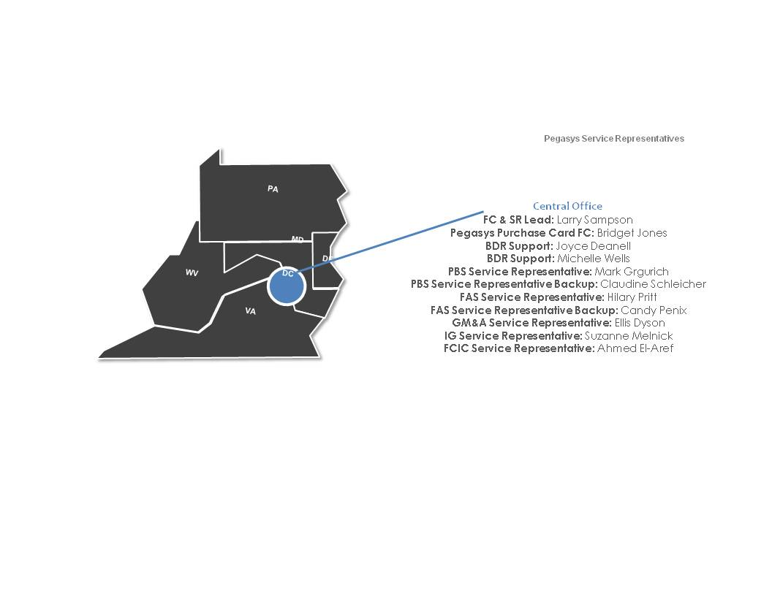
Functional Coordinator/Service Representative
Quick Reference Card
U.S. General Services Administration
SR/FC Directories
Region | Name | Role | Email
1 | Rudolph Agnite | FC | rudolf.agnite@gsa.gov
2 | Joe Musolino | PBS FC | joseph.musolino@gsa.gov
2 | Lynn Zhao | FAS FC | lynn.zhao@gsa.gov
3 | Maria McDermott | PBS FC | maria.mcdermott@gsa.gov
3 | Jacki Skinner | FAS FC | jacki.skinner@gsa.gov
3 | Vanessa Nguyen | FAS Backup | vanessa.nguyen@gsa.gov
3 | Patti Mullen | FAS Backup | patti.mullen@gsa.gov
4 | Greta Carter | FC | greta.carter@gsa.gov
4 | Janice Evans | Backup | janice.evans@gsa.gov
5 | Amanda MacKenzie | PBS FC | amanda.mackenzie@gsa.gov
5 | Sara Haegele | FAS FC | sara.haegele@gsa.gov
6 | Gene Moraine | FC | eugene.moraine@gsa.gov
6 | William McKaig | Backup | william.mckaig@gsa.gov
7 | Michelle Watts | FC | michelle.watts@gsa.gov
8 | Shaon Kajewski | PBS FC | sharon.kajewski@gsa.gov
8 | Susan Marquez | FAS FC | susan.marquez@gsa.gov
8 | Shirley Longihini Owen | PBS Backup | shirley.longhini@gsa.gov
8 | Laura Roberts | FAS Backup | laura.roberts@gsa.gov
9 | Sandy Hom | FC | sandra.hom@gsa.gov
9 | Hoa Hua | Backup | hoa.hua@gsa.gov
10 | Tamira Mitchell | FC | tamira.mitchell@gsa.gov
10 | Linda Petorak | PBS Backup | linda.petorak@gsa.gov
NCR | Anthony Marable | FC | anthony.marable@gsa.gov
NCR | Gail Hairston | FC | gail.hairston@gsa.gov
NCR | Adrienne Wilkins | FC | adrienne.wilkins@gsa.gov
Functional Coordinators in Regions
Service Representatives in Central Office
Name | Role | Email
Larry Sampson | FC & SR Lead | larry.sampson@gsa.gov
Bridget Jones | FC & SR Lead Backup | bridget.jones@gsa.gov
Joyce Deanell | BDA Support | joyce.deanell@gsa.gov
Michelle Wells | BDR Support | michelle.wells@gsa.gov
Mark Grgurich | PBS Service Representative | mark.grgurich@gsa.gov
Claudine Schleicher | PBS Service Representative Backup | claudine.schleicher@gsa.gov
Hilary Pritt | FAS Service Representative | hilary.pritt@gsa.gov
Candy Penix | FAS Service Representative Backup | candy.penix@gsa.gov
Ellis Dyson | GM&A Service Representative | ellis.dyson@gsa.gov
Suzanne Melnick | IG Service Representative | suzanne.melnick@gsaig.gov
Ahmed El-Aref | FCIC Service Representative | ahmed.el-aref@gsa.gov
Notes:
Laura Roberts should be added in Region 8 instead of Susan Marquez
Linda Petrorak removed from Region 10

